Slide 1
PayEase: Digital Payments App – Product Strategy and Roadmap
Key market insights and plans for payment innovation
Notes:
AI-generated content may be incorrect. --- Welcome to the presentation on PayEase's product strategy and roadmap. We will explore market opportunities, product vision, technical architecture, competitive analysis, and go-to-market plans to understand how PayEase will succeed in the digital payments space.

Slide 2
Agenda Overview: Key Discussion Points
Market Opportunity and User Insights
Product Vision, Strategy, and Value Propositions
Feature Requirements and Prioritisation
Technical Architecture and Security
Success Metrics and KPIs
Competitive Analysis and Positioning
Go-to-Market Strategy and Launch Plan
Product Roadmap and Risk Assessment
Notes:
This presentation will cover eight major sections: Market Opportunity and User Insights, Product Vision and Strategy, Feature Requirements and Prioritisation, Technical Architecture and Security, Success Metrics and KPIs, Competitive Analysis and Positioning, Go-to-Market Strategy, and Product Roadmap and Risk Assessment. Each section will dive into specific subtopics.

Slide 3
Market Opportunity and User Insights
Notes:
Digital Payments Market Size and Growth Drivers, Key Market Gaps and User Pain Points, User Personas and Their Needs, User Journey Mapping for Core Payment Scenarios

Slide 4

Digital Payments Market Size and Growth Drivers
Market Size Overview
India's digital payments market is valued over $500 billion by 2025, highlighting significant opportunity.
Serviceable Market Segments
Mobile payments segment targets $150 billion with achievable 1% market share worth $1.5 billion in 3 years.
Key Growth Drivers
Growth stems from smartphone penetration, COVID-19 digital shift, government cashless push, and rural internet expansion.
Notes:
--- Market Size & Opportunity Total Addressable Market (TAM): $500B+ (India's digital payments market by 2025) Serviceable Addressable Market (SAM): $150B (Mobile payments segment) Serviceable Obtainable Market (SOM): $1.5B (Target 1% market share in 3 years) Key Market Insights Growth Drivers: Digital India initiative and smartphone penetration (750M+ users) COVID-19 accelerated digital payment adoption (40% YoY growth) Government push for cashless transactions Rising internet connectivity in rural areas Image source: Microsoft 365 content library

Slide 5
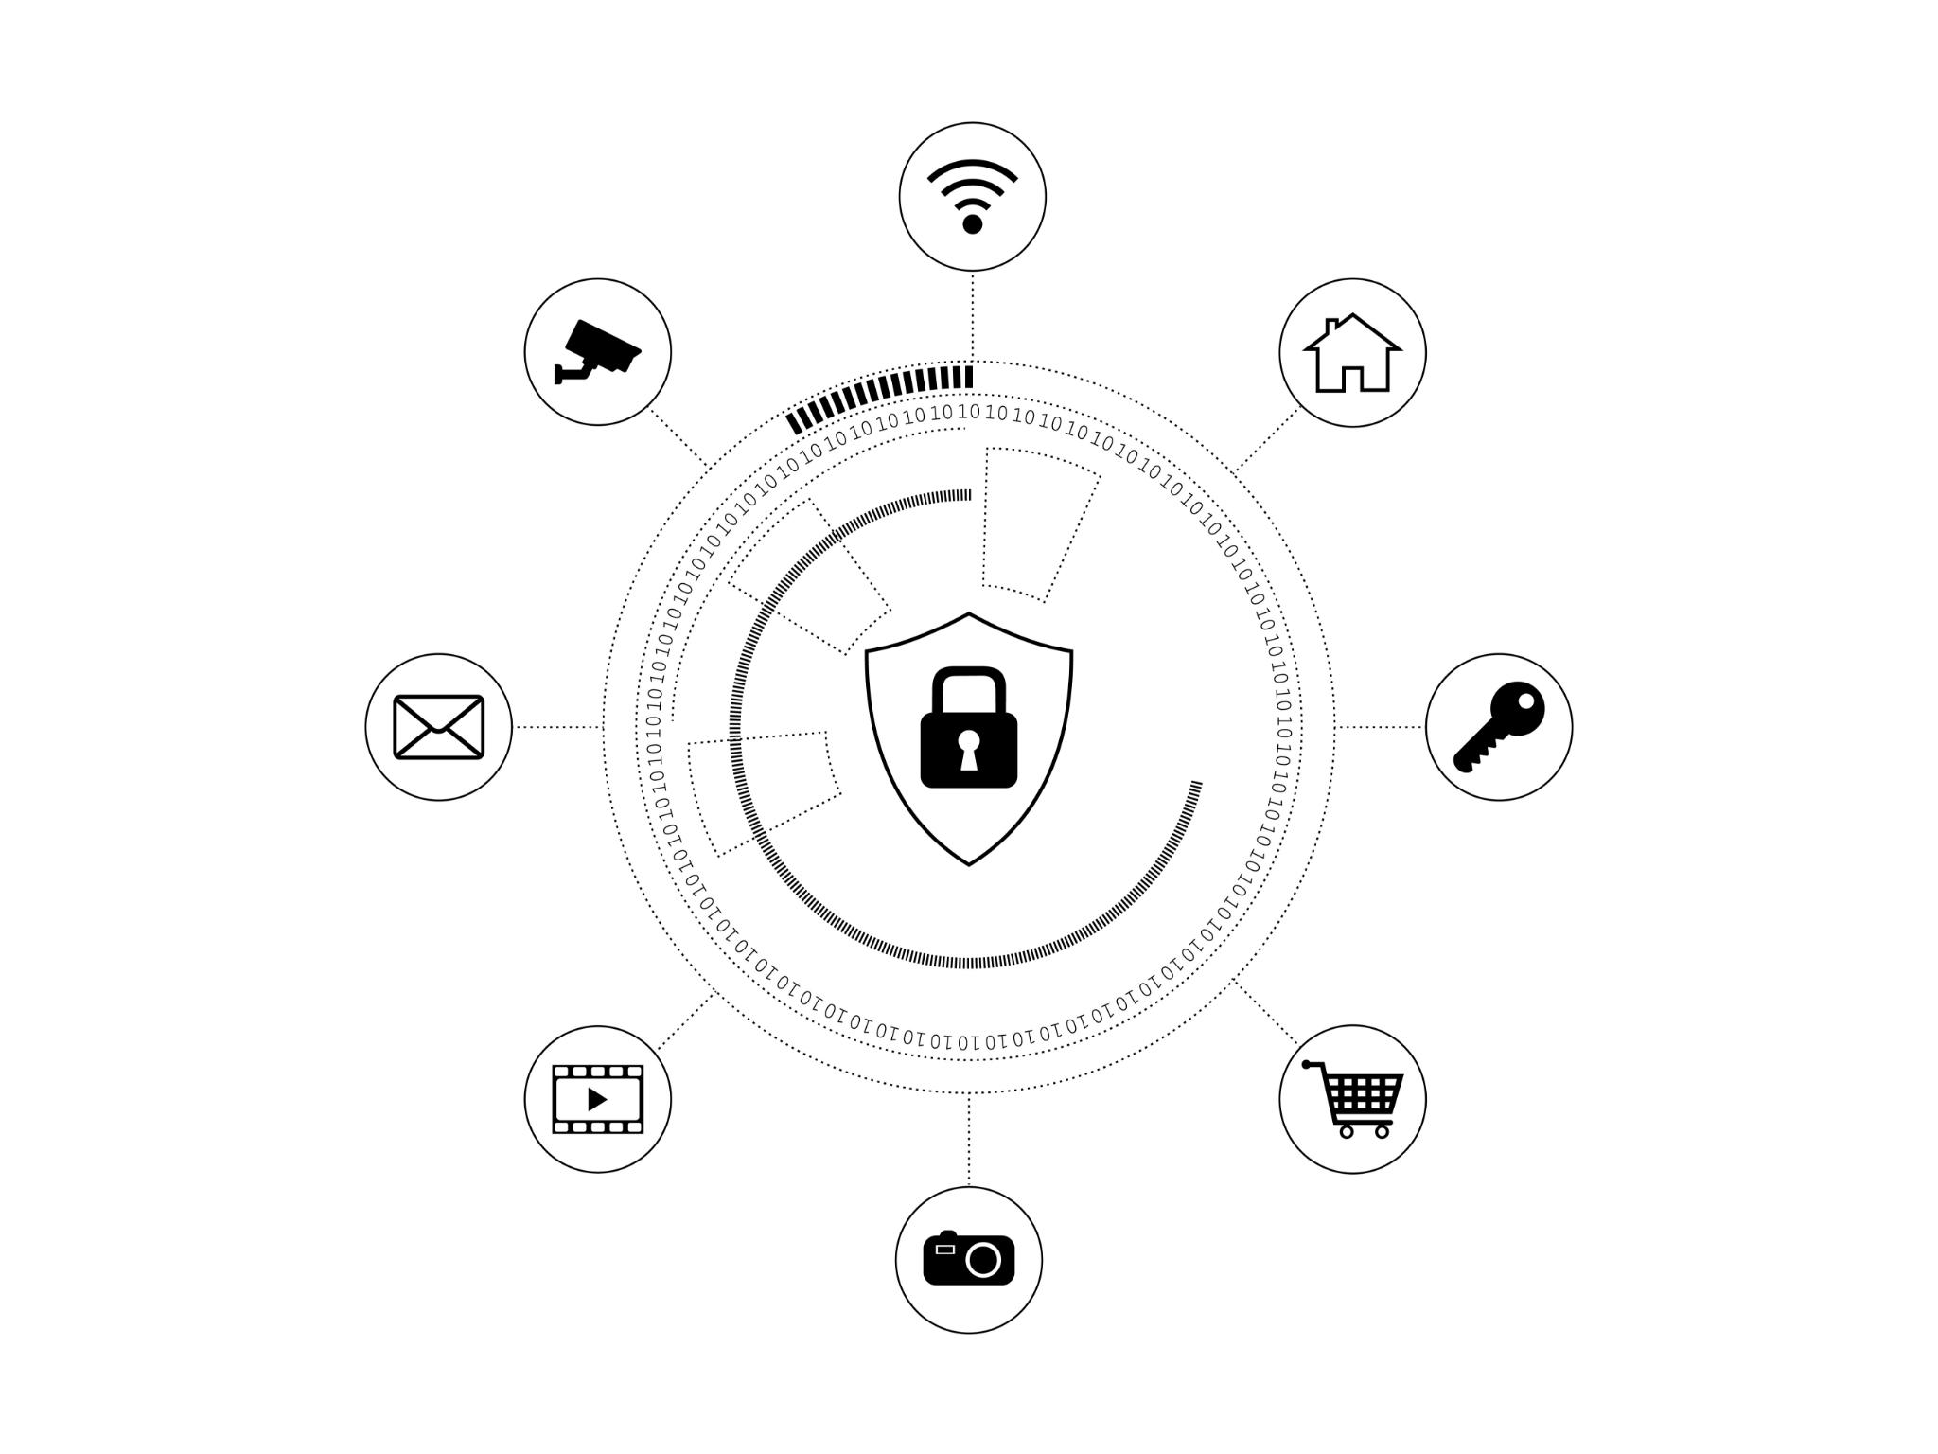
Key Market Gaps and User Pain Points
Financial Literacy Gaps
Low financial literacy and limited digital payment awareness persist in tier 2 and 3 cities, hindering adoption.
Fragmented User Experience
Users face fragmented experiences using multiple payment apps, causing confusion and inefficiency.
Expense Management Needs
Lack of comprehensive tools for expense tracking leads 82% of users to seek better spending insights.
Security and Merchant Access Concerns
Concerns over transaction security affect 74% of users, while 61% struggle to find merchants accepting digital payments.
Notes:
--- Market Gaps Identified: Limited financial literacy and digital payment awareness in tier 2/3 cities Fragmented user experience across multiple payment apps Lack of comprehensive expense management tools Limited merchant discovery and loyalty programs User Research Findings Primary Research: Conducted 50+ user interviews across Delhi, Mumbai, Bangalore, and Jaipur Survey Data: 500+ responses through online surveys Key Pain Points: Transaction Complexity: 68% users find multiple apps confusing Security Concerns: 74% worried about transaction security Poor Expense Tracking: 82% want better spending insights Limited Merchant Options: 61% struggle to find nearby merchants accepting digital payments Image source: Microsoft 365 content library

Slide 6

User Personas and Their Needs
Digital Native Deepak
Young, tech-savvy urban user seeking quick, secure transactions and efficient expense management.
Small Business Savita
Small business owner in tier 2 city needing easy digital payments and simple financial solutions.
Family-First Priya
Moderately digitally literate homemaker focused on safe transactions and easy app usability.
Notes:
--- Primary Personas Persona 1: "Digital Native Deepak" Demographics: Age: 25-35 Location: Metro cities (Mumbai, Delhi, Bangalore) Income: ₹8-15 LPA Tech-savvy, early adopter Goals: Quick and secure transactions Expense tracking and budgeting Cashback and rewards Seamless merchant payments Pain Points: Managing multiple payment apps Lack of comprehensive financial insights Security concerns with new platforms Persona 2: "Small Business Savita" Demographics: Age: 30-45 Location: Tier 2 cities (Pune, Jaipur, Indore) Business: Small retail/services Moderate tech comfort Goals: Accept digital payments from customers Track business transactions Access to business loans/credit Simple, reliable payment solution Pain Points: Complex onboarding processes High transaction fees Limited customer support in local language Difficulty in reconciling payments Persona 3: "Family-First Priya" Demographics: Age: 28-40 Location: Tier 2/3 cities Role: Homemaker/working professional Moderate digital literacy Goals: Send money to family members Pay household bills Safe and secure transactions Easy-to-use interface Pain Points: Complicated app interfaces Language barriers Fear of digital fraud Lack of customer support Image source: Microsoft 365 content library

Slide 7
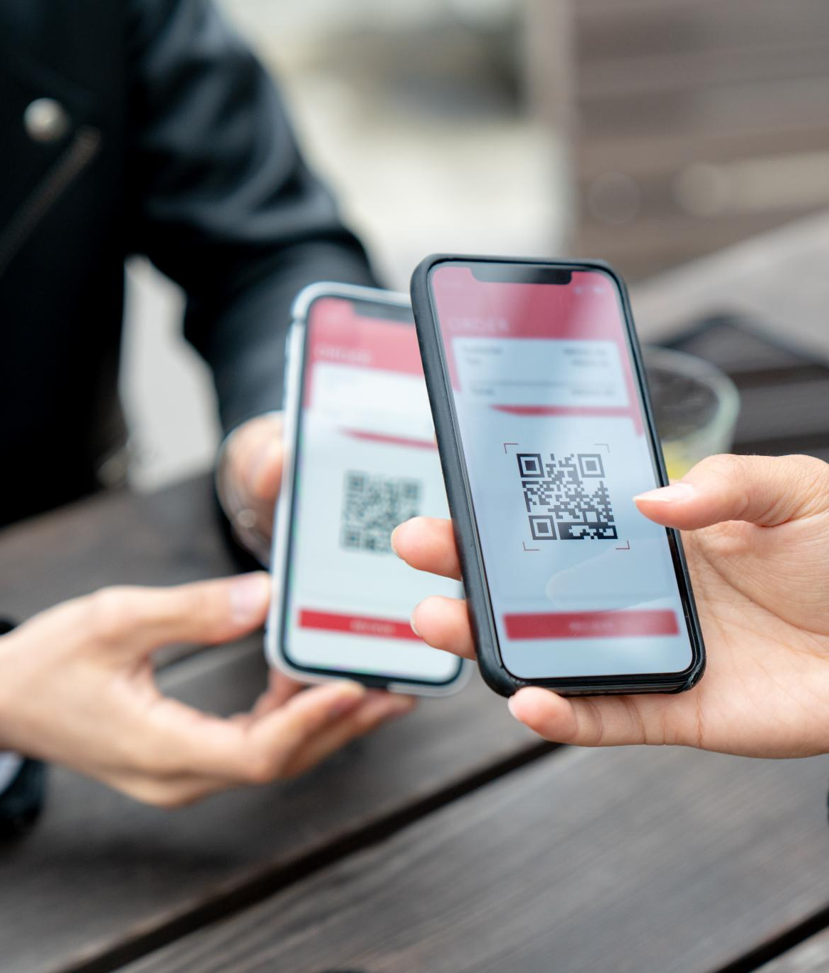
User Journey Mapping for Core Payment Scenarios
P2P Money Transfer Journey
User initiates sending money through an app, authenticates biometrically, and receives confirmation with automatic expense categorization.
Merchant Payment Journey
Business owner generates a QR code for customer payment, receives real-time notification, and sees instant settlement in account.
Notes:
--- User Journey Maps Journey 1: P2P Money Transfer (Deepak) Trigger: Need to split dinner bill with friends Awareness: Opens PayEase app Action: Selects "Send Money" → Enters amount → Selects contact Payment: Authenticates with biometric → Transaction successful Post-Transaction: Receives confirmation → Updates expense category Satisfaction: Quick, secure, automatically categorized Journey 2: Merchant Payment (Savita - Business Owner) Trigger: Customer wants to pay digitally Awareness: Opens PayEase Business dashboard Action: Generates QR code → Customer scans and pays Payment: Receives real-time notification Post-Transaction: Payment reflected in business account Satisfaction: Instant settlement, clear transaction record Image source: Microsoft 365 content library

Slide 8
Product Vision, Strategy, and Value Propositions
Notes:
Vision Statement and Strategic Objectives, Core Product Principles and Differentiators

Slide 9
Vision Statement and Strategic Objectives
Vision Statement
Democratize digital payments in India through a secure, unified platform empowering all users.
User Acquisition Target
Aim to register over 5 million users within 18 months to expand platform reach and usage.
Transaction Volume Goal
Target achieving an annual transaction volume exceeding $2 billion to boost economic activity.
Market and Merchant Expansion
Expand presence to 100+ cities and onboard 100,000+ merchant partners, including tier 2/3 markets.
Financial Inclusion Effort
Enable over 1 million first-time digital payment users to increase financial inclusion nationwide.
Notes:
Vision Statement "To democratize digital payments in India by providing a unified, secure, and intelligent payment platform that empowers every Indian to participate in the digital economy." Strategic Objectives (18 months) User Acquisition: 5M+ registered users Transaction Volume: $2B+ annual transaction volume Market Expansion: Presence in 100+ cities including tier 2/3 markets Merchant Network: 100K+ merchant partners Financial Inclusion: Enable 1M+ first-time digital payment users

Slide 10

Core Product Principles and Differentiators
Security First
Bank-grade security ensures all transactions are protected with transparent fraud prevention measures.
Simplicity and Inclusivity
Intuitive design supports all user segments with multi-language and accessibility features for inclusivity.
AI-Driven Intelligence
AI-powered insights provide personalized financial management and expense tracking for users.
Regional and Merchant Focus
Focus on tier 2/3 cities with local language support and comprehensive merchant business tools.
Notes:
--- Product Principles Security First: Bank-grade security for all transactions Simplicity: Intuitive design for all user segments Inclusivity: Multi-language support and accessibility features Intelligence: AI-driven insights and personalization Reliability: 99.9% uptime and instant transaction processing Key Differentiators: AI-powered financial insights and expense management Merchant-first approach with comprehensive business tools Regional focus on tier 2/3 cities with local language support Security-first design with transparent fraud protection Image source: Microsoft 365 content library

Slide 11
Feature Requirements and Prioritisation
Notes:
Feature Prioritisation Frameworks and MVP Features, Enhanced Features and Future Roadmap, Detailed Specifications for Key Features

Slide 12
Feature Prioritisation Frameworks and MVP Features
Feature | Reach | Impact | Confidence | Effort | RICE Score | Priority
UPI Integration | 5M | 3 | 90% | 8 | 168.75 | P0
P2P Transfers | 5M | 3 | 95% | 6 | 237.50 | P0
Bill Payments | 3M | 2 | 85% | 4 | 127.50 | P0
QR Code Payments | 4M | 3 | 90% | 5 | 216.00 | P0
Expense Tracking | 2M | 3 | 80% | 6 | 80.00 | P1
Merchant Discovery | 1.5M | 2 | 70% | 7 | 30.00 | P1
Rewards Program | 2M | 2 | 75% | 8 | 37.50 | P2
Business Dashboard | 500K | 3 | 85% | 10 | 12.75 | P2
Notes:
Feature Prioritization Framework Using RICE Scoring (Reach × Impact × Confidence ÷ Effort): MoSCoW Prioritization Must Have (P0 - MVP Features) User Registration & KYC Mobile number verification Aadhaar-based KYC Bank account linking Security PIN setup UPI Integration UPI ID creation and management Bank account integration Transaction limits management NPCI compliance P2P Money Transfers Contact-based transfers UPI ID-based transfers Mobile number-based transfers Transaction history QR Code Payments Static and dynamic QR scanning Merchant QR payments P2P QR transfers QR code generation Bill Payments Utility bills (electricity, water, gas) Mobile recharges DTH recharges Insurance payments MoSCoW Prioritization Must Have (P0 - MVP Features) User Registration & KYC Mobile number verification Aadhaar-based KYC Bank account linking Security PIN setup UPI Integration UPI ID creation and management Bank account integration Transaction limits management NPCI compliance P2P Money Transfers Contact-based transfers UPI ID-based transfers Mobile number-based transfers Transaction history QR Code Payments Static and dynamic QR scanning Merchant QR payments P2P QR transfers QR code generation Bill Payments Utility bills (electricity, water, gas) Mobile recharges DTH recharges Insurance payments

Slide 13
Enhanced Features and Future Roadmap
Feature | Reach | Impact | Confidence | Effort | RICE Score | Release
Expense Analytics | 2M | 3 | 85% | 6 | 85.0 | v1.1
Merchant Discovery | 1.5M | 2 | 80% | 4 | 60.0 | v1.1
Business Dashboard | 100K | 3 | 90% | 8 | 33.75 | v1.2
Rewards Program | 2M | 2 | 75% | 6 | 50.0 | v1.2
Credit Integration | 1M | 3 | 70% | 10 | 21.0 | v2.0
Investment Platform | 500K | 3 | 60% | 12 | 7.5 | v2.0
Notes:
Should Have (P1 - Version 1.1) Expense Tracking Automatic transaction categorization Monthly spending analysis Budget setting and alerts Spending insights and trends Merchant Discovery Location-based merchant search Merchant categories and filters Store ratings and reviews Nearby offers and deals Enhanced Security Biometric authentication Transaction alerts Fraud detection system Emergency account freeze Could Have (P2 - Version 1.2+) Rewards & Loyalty Cashback on transactions Loyalty points system Referral rewards Merchant-specific offers Business Features Merchant onboarding Business analytics dashboard Bulk payment options Invoice generation

Slide 14
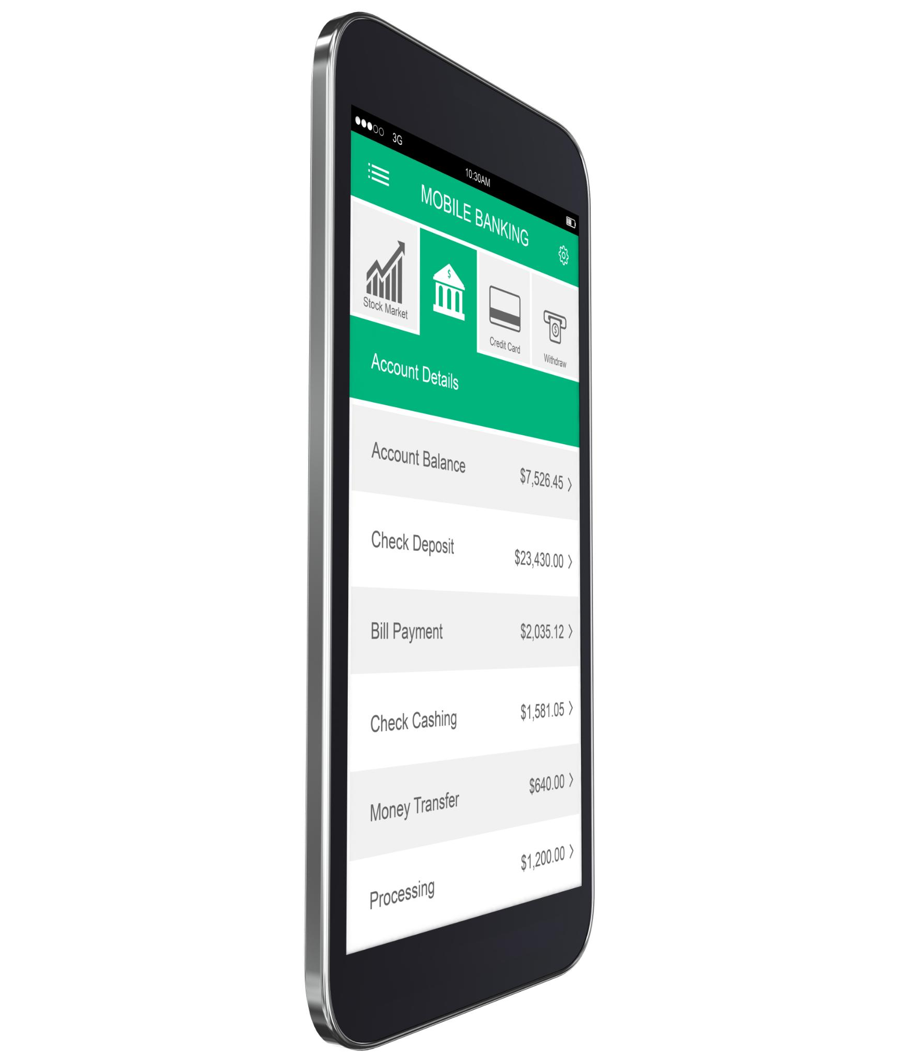
Detailed Specifications for Key Features
UPI Integration Features
Allows linking multiple bank accounts with real-time balance checks and secure transaction handling.
P2P Money Transfers
Supports quick, secure peer-to-peer payments with multiple recipient options and instant confirmations.
Expense Tracking and Insights
Provides detailed spending analytics, budget alerts, and customizable categorization for financial control.
Notes:
--- Detailed Feature Specifications Feature 1: UPI Integration User Story: As a user, I want to link my bank account and create a UPI ID so that I can make instant payments. Acceptance Criteria: User can link multiple bank accounts UPI ID follows standard format (name@payease) Real-time balance checking Support for all major UPI-enabled banks Transaction limits as per NPCI guidelines Failed transaction handling and retry mechanism Technical Requirements: Integration with NPCI UPI APIs Bank account verification through penny drop Encrypted storage of banking details Real-time transaction status updates Feature 2: P2P Money Transfers User Story: As a user, I want to send money to friends and family quickly and securely. Acceptance Criteria: Multiple recipient selection methods (contacts, UPI ID, mobile number) Amount validation and limit checks Transaction notes and references Instant transaction confirmation Transaction failure handling Split bill functionality Technical Requirements: Contact list access and synchronization Push notifications for transaction updates Transaction encryption and security Database logging for audit trails Feature 3: Expense Tracking User Story: As a user, I want to track my spending patterns and receive insights about my financial habits. Acceptance Criteria: Automatic transaction categorization (>85% accuracy) Manual category editing capability Monthly/weekly spending summaries Budget setting with alerts at 80% threshold Visual spending analytics (charts, graphs) Export functionality for transaction data Technical Requirements: Machine learning models for transaction categorization Data analytics and reporting engine Push notification system for budget alerts Data visualization libraries integration Image source: Microsoft 365 content library

Slide 15
Technical Architecture and Security
Notes:
System Architecture and Technology Stack, API Specifications and Data Protection, Fraud Prevention and Performance Requirements, Third-Party Integrations and Compliance

Slide 16

System Architecture and Technology Stack
High-Level Architecture
The system uses a modular design connecting mobile apps, API gateway, microservices, and databases.
Frontend Technology Stack
React Native powers the mobile app with Redux for state management and React Navigation for routing.
Backend and Data Services
Node.js with Express handles backend services while MongoDB, PostgreSQL, and Redis manage data storage and caching.
Cloud Infrastructure and DevOps
AWS cloud services, Kubernetes orchestration, monitoring tools, and Jenkins CI/CD streamline deployment and operations.
Notes:
--- System Architecture High-Level Architecture [Mobile App] ↔ [API Gateway] ↔ [Microservices] ↔ [Database] ↓ [External APIs] (UPI, Banks, NPCI) Technology Stack Frontend (Mobile App): Platform: React Native for cross-platform development State Management: Redux Toolkit UI Framework: React Native Elements Navigation: React Navigation 6 Testing: Jest, Detox for E2E testing Backend Services: Runtime: Node.js with Express.js framework Database: MongoDB for user data, PostgreSQL for transactions Caching: Redis for session management and API caching Message Queue: RabbitMQ for transaction processing API Documentation: Swagger/OpenAPI Infrastructure: Cloud Platform: AWS (Amazon Web Services) Container Orchestration: AWS EKS (Kubernetes) CDN: AWS CloudFront Monitoring: AWS CloudWatch, New Relic CI/CD: Jenkins with Docker containers Appendix B: Technical Architecture Diagrams System Architecture Overview ┌─────────────────┐ ┌─────────────────┐ ┌─────────────────┐ │ Mobile App │ │ Web Portal │ │ Merchant App │ │ (React Native) │ │ (React.js) │ │ (Flutter/React) │ └─────────┬───────┘ └─────────┬───────┘ └─────────┬───────┘ │ │ │ └──────────────────────┼──────────────────────┘ │ ┌─────────────▼───────────────┐ │ API Gateway │ │ (Kong/AWS API Gateway) │ └─────────────┬───────────────┘ │ ┌───────────────────────┼───────────────────────┐ │ │ │ ┌─────────▼─────────┐ ┌─────────▼─────────┐ ┌─────────▼─────────┐ │ User Service │ │ Payment Service │ │ Merchant Service │ │ (Node.js) │ │ (Node.js) │ │ (Node.js) │ └─────────┬─────────┘ └─────────┬─────────┘ └─────────┬─────────┘ │ │ │ └───────────────────────┼───────────────────────┘ │ ┌─────────────▼───────────────┐ │ Data Layer │ │ MongoDB + PostgreSQL + Redis│ └─────────────────────────────┘ Image source: Microsoft 365 content library

Slide 17
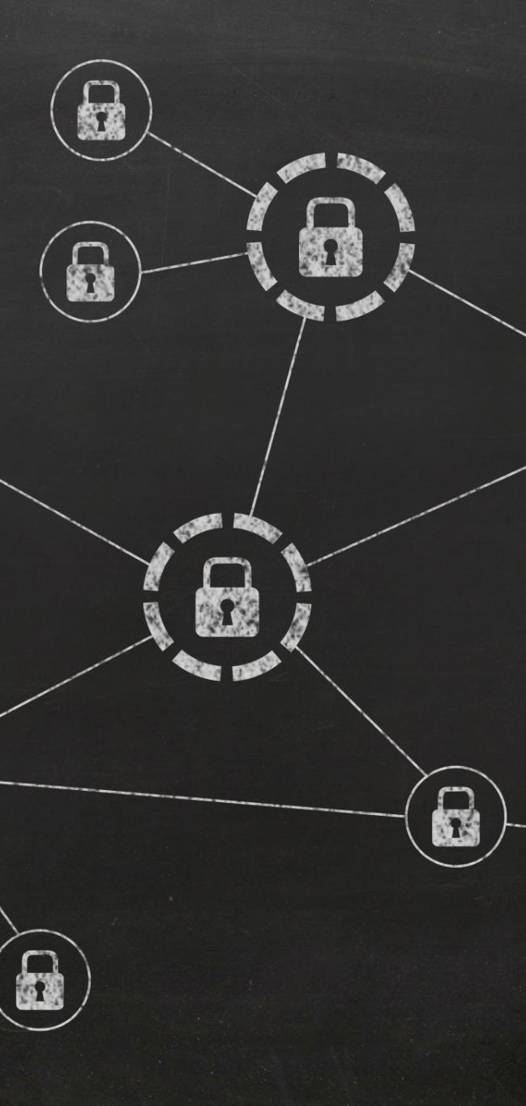
API Specifications and Data Protection
Core API Functionalities
User management, payment processing, and UPI integration are key APIs enabling seamless service operations.
Authentication and Authorization
Multi-factor authentication and role-based access ensure secure and controlled user access.
Data Protection Measures
Data encryption, tokenization, and compliance with PCI DSS safeguard sensitive information effectively.
Session and Data Management
Secure session handling with timeout and automatic data purging maintain system integrity and compliance.
Notes:
--- API Specifications Core APIs 1. User Management API POST /api/v1/users/register { "mobile": "+91XXXXXXXXXX", "name": "User Name", "email": "user@example.com" } POST /api/v1/users/verify-otp { "mobile": "+91XXXXXXXXXX", "otp": "123456" } GET /api/v1/users/profile Headers: Authorization: Bearer {token} 2. Payment Processing API POST /api/v1/payments/transfer { "sender_upi": "user@payease", "receiver_upi": "friend@payease", "amount": 500.00, "currency": "INR", "note": "Dinner split" } GET /api/v1/payments/history Headers: Authorization: Bearer {token} Query: ?limit=20&offset=0&from_date=2024-01-01 3. UPI Integration API POST /api/v1/upi/create-id { "user_id": "user123", "preferred_id": "john", "bank_account": "account_reference" } POST /api/v1/upi/collect-request { "payer_upi": "payer@bank", "amount": 1000.00, "reference": "TXN123456" } Security Requirements Authentication & Authorization Multi-factor Authentication: SMS OTP + Biometric JWT Tokens: Short-lived access tokens (15 min) with refresh tokens Role-based Access Control: User/Merchant/Admin roles Session Management: Secure session handling with timeout Data Protection Encryption: AES-256 for data at rest, TLS 1.3 for data in transit PII Protection: Tokenization of sensitive user data PCI DSS Compliance: For payment card data handling Data Retention: Automatic data purging as per regulations Image source: Microsoft 365 content library

Slide 18

Fraud Prevention and Performance Requirements
Fraud Detection Techniques
Real-time algorithms and machine learning detect unusual transactions and identify unique devices to prevent fraud.
Dynamic Transaction Controls
Transaction limits adapt dynamically based on user behaviour to limit potential fraudulent activities.
Performance and Scalability
System supports 100,000 users concurrently and processes 10,000 transactions per minute with low latency.
Availability and Disaster Recovery
99.9% uptime with multi-region backups and auto-scaling load balancing ensures reliability and quick recovery.
Notes:
--- Fraud Prevention Transaction Monitoring: Real-time fraud detection algorithms Device Fingerprinting: Unique device identification Behavioral Analysis: ML-based unusual activity detection Transaction Limits: Dynamic limits based on user behavior Performance Requirements Scalability Targets Concurrent Users: 100K simultaneous active users Transaction Throughput: 10K transactions per minute Database Performance: <100ms query response time API Response Time: <500ms for 95th percentile Availability Requirements Uptime: 99.9% availability (8.77 hours downtime/year) Disaster Recovery: RTO <4 hours, RPO <1 hour Load Balancing: Auto-scaling based on traffic patterns Database Replication: Multi-region backup and replication Image source: Microsoft 365 content library

Slide 19
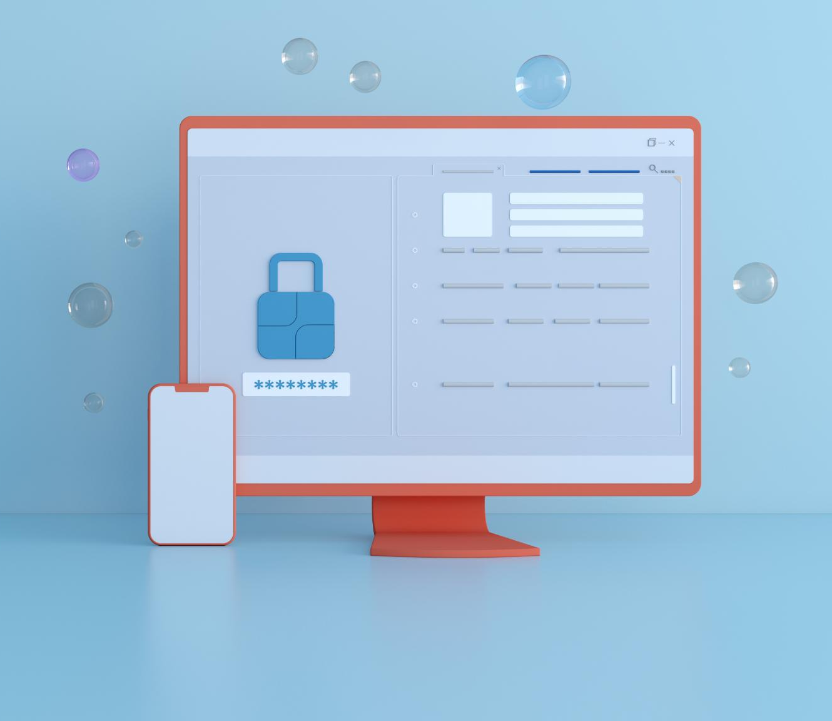
Third-Party Integrations and Compliance
Payment Gateways Integration
Integration with NPCI UPI as primary and Razorpay/PayU as backup ensures seamless payment processing.
External Service Connections
Utilising SMS gateways, email services, KYC Aadhaar authentication, and credit bureau integration for robust functionality.
RBI Regulatory Compliance
Strict adherence to RBI regulations including PSO authorization, KYC, AML, FEMA, and data localization requirements.
Data Protection and Privacy
Compliance with PDPB, consent management, data retention policies, and privacy controls to secure user data.
Notes:
--- Third-Party Integrations Payment Gateways NPCI UPI: Primary payment rail Razorpay/PayU: Backup payment processing Bank APIs: Direct integration with major banks BBPS: Bharat Bill Payment System for bill payments External Services SMS Gateway: For OTP delivery (AWS SNS, Twilio) Email Service: Transaction notifications (SendGrid) KYC Services: Aadhaar authentication (UIDAI) Credit Bureau: CIBIL integration for future credit features Appendix D: Regulatory Compliance Checklist RBI Compliance Requirements Payment System Operator (PSO) authorization KYC compliance as per RBI guidelines AML (Anti-Money Laundering) procedures FEMA compliance for international transactions Data localization as per RBI circular Fraud monitoring and reporting systems Customer grievance redressal mechanism Regular audit and compliance reporting NPCI UPI Compliance Technical integration with UPI infrastructure Security certification and testing Transaction limit compliance Merchant onboarding process adherence Dispute resolution mechanism Regular compliance monitoring Data Protection and Privacy Personal Data Protection Bill (PDPB) compliance Consent management framework Data retention and deletion policies Cross-border data transfer agreements Regular data protection audits User privacy controls and transparency Image source: Microsoft 365 content library

Slide 20
Success Metrics and KPIs
Notes:
North Star Metric and User Engagement KPIs, Transaction and Business Health Metrics, Product-Specific KPIs and Measurement Framework, Milestones for MVP, Product-Market Fit, and Scale

Slide 21
North Star Metric and User Engagement KPIs
Metric | Target (Month 6) | Target (Month 12) | Target (Month 18)
Monthly Active Users (MAU) | 500K | 2M | 5M
Daily Active Users (DAU) | 150K | 600K | 1.5M
User Retention (Day 30) | 35% | 45% | 50%
App Store Rating | 4.2+ | 4.4+ | 4.5+
Notes:
North Star Metric Total Payment Volume (TPV): Monthly transaction value processed through the platform Key Performance Indicators User Acquisition & Engagement

Slide 22
Transaction and Business Health Metrics
Metric | Target (Month 6) | Target (Month 12) | Target (Month 18)
Monthly Transaction Volume | $50M | $200M | $500M
Average Transaction Size | $15 | $20 | $25
Transactions per User/Month | 8 | 12 | 15
Transaction Success Rate | 98% | 99% | 99.5%
Notes:
Transaction Metrics Business Health

Slide 23

Product-Specific KPIs and Measurement Framework
Key Performance Indicators
P2P transfers dominate transaction volume with fast, reliable completion and high success rates.
Bill Payment Metrics
Bill payments show strong user adoption, high repeat usage, and consistent average payment value.
Merchant Payment Metrics
Merchant onboarding and transaction volume steadily grow, with solid monthly retention rates.
Measurement and Reporting Framework
Data collected through analytics, user feedback, and transaction monitoring supports daily to quarterly reporting cycles.
Notes:
--- Product-Specific KPIs P2P Transfers: P2P transaction volume: 60% of total TPV Average P2P transaction time: <30 seconds P2P transaction success rate: 99%+ Bill Payments: Bill payment adoption: 40% of users Repeat bill payments: 80% monthly retention Average bill payment value: $20 Merchant Payments: Merchant onboarding: 1K merchants/month by Month 6 Merchant transaction volume: 25% of total TPV Merchant retention rate: 70% monthly Measurement Framework Data Collection App Analytics: Firebase Analytics, Mixpanel User Feedback: In-app surveys, App Store reviews Transaction Data: Real-time transaction monitoring Customer Support: Support ticket analysis and resolution times Reporting Schedule Daily: Transaction volumes, success rates, technical metrics Weekly: User engagement, retention, support metrics Monthly: Business metrics, cohort analysis, competitive benchmarking Quarterly: Strategic KPI review, goal adjustment Image source: Microsoft 365 content library

Slide 24

Milestones for MVP, Product-Market Fit, and Scale
MVP Success Metrics
Achieve 100K registered users and $10M monthly transactions by month 3, with high transaction success and app rating.
Product-Market Fit Indicators
Reach 500K monthly active users with 30% retention by month 6, strong NPS and organic growth over 50%.
Scale Validation Goals
Expand to 2M users and lead in multiple cities by month 12, with profitable unit economics and high retention.
Notes:
--- Success Criteria MVP Success (Month 3) 100K registered users $10M monthly transaction volume 95%+ transaction success rate 4.0+ app store rating Product-Market Fit (Month 6) 500K MAU with 30%+ retention $50M monthly TPV NPS score 30+ Organic growth >50% of new users Scale Validation (Month 12) 2M MAU with 45%+ retention $200M monthly TPV Market leader in 2+ cities Profitable unit economics Image source: Microsoft 365 content library

Slide 25
Competitive Analysis and Positioning
Notes:
Competitive Landscape and Direct Competitors, PayEase Unique Value Propositions, Feature Comparison Matrix, Competitive Strategy: Short, Medium, and Long Term

Slide 26
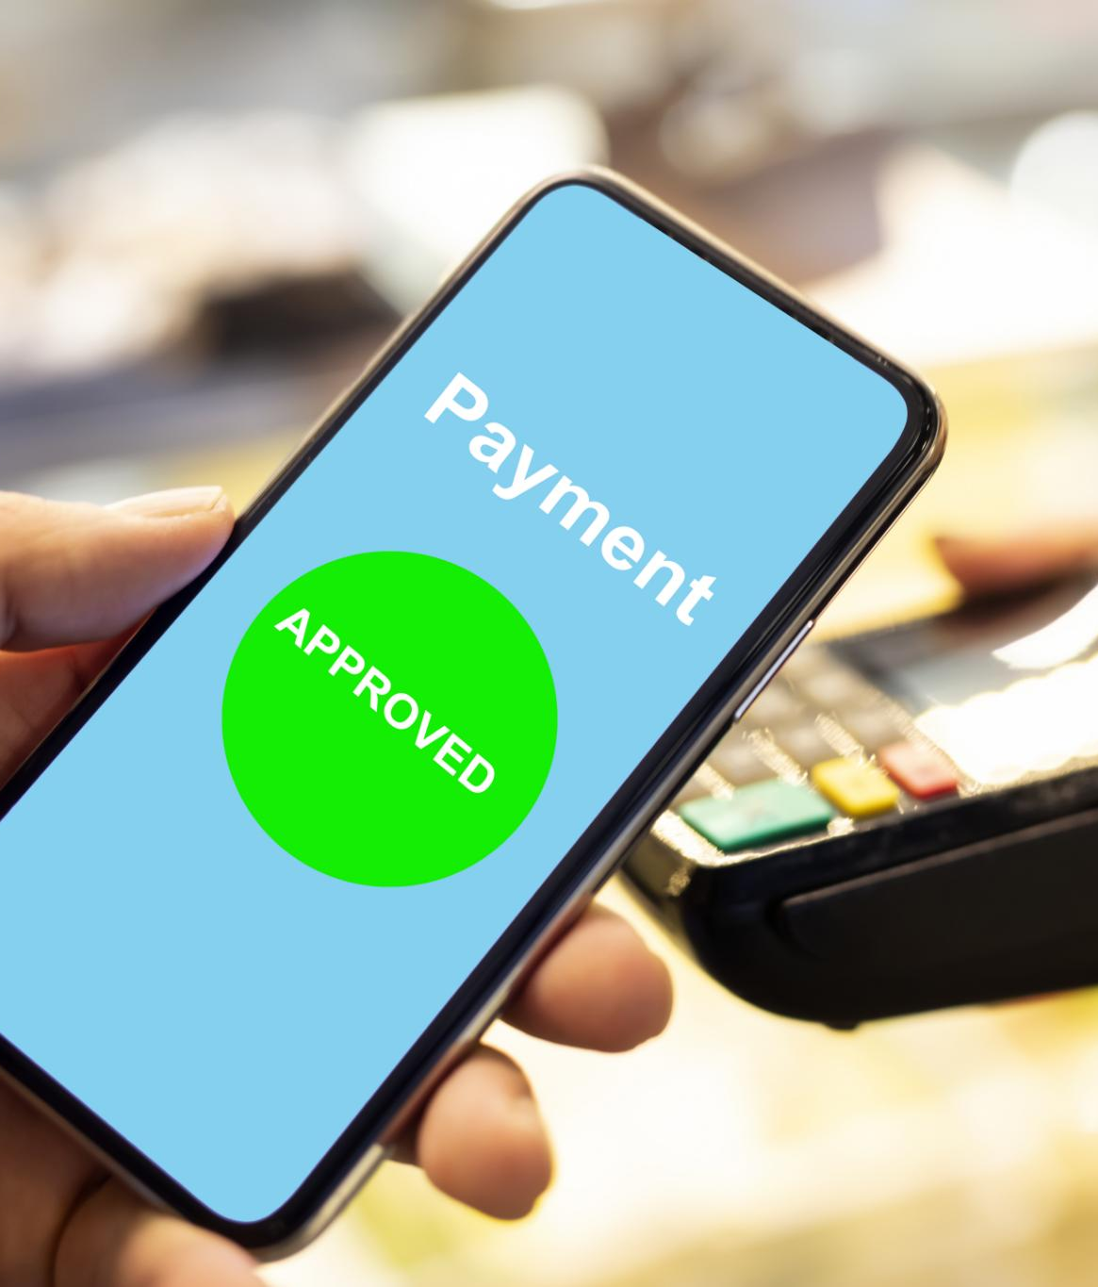
Competitive Landscape and Direct Competitors
PhonePe Market Position
PhonePe leads with 47% market share, benefiting from wide merchant access and Walmart support.
Google Pay Integration
Google Pay holds 34% market share, noted for its Google ecosystem integration and rewards.
Paytm Market Challenges
Paytm commands 13% market share but faces challenges with app complexity and trust issues.
Notes:
--- Competitive Landscape Direct Competitors 1. PhonePe Market Share: 47% (by transaction volume) Strengths: Wide merchant network, Walmart backing, diverse services Weaknesses: Complex interface, limited personalization Differentiation Opportunity: Better UX, AI-powered insights 2. Google Pay (GPay) Market Share: 34% (by transaction volume) Strengths: Google ecosystem integration, rewards program Weaknesses: Limited bill payment options, occasional reliability issues Differentiation Opportunity: Comprehensive bill payments, better customer support 3. Paytm Market Share: 13% (by transaction volume) Strengths: Early mover, diverse fintech services, offline presence Weaknesses: Complex app, declining market share, trust issues Differentiation Opportunity: Simplified focus, enhanced security Image source: Microsoft 365 content library

Slide 27

PayEase Unique Value Propositions
Intelligent Financial Assistant
AI powers expense categorization, offers spending insights, and sends predictive bill reminders.
Merchant-First Approach
Quick merchant onboarding with real-time analytics and integrated inventory tracking enhances business management.
Regional Focus
Supports multiple languages and tier 2/3 city features with local customer support in regional languages.
Security Excellence
Advanced fraud detection with insurance and transparent security practices ensure user trust and safety.
Notes:
--- PayEase Unique Value Propositions 1. Intelligent Financial Assistant AI-powered expense categorization and insights Personalized spending recommendations Predictive bill reminders and payment suggestions 2. Merchant-First Approach Simplified merchant onboarding (5-minute setup) Real-time business analytics dashboard Integrated inventory and sales tracking 3. Regional Focus Multi-language support (Hindi, English + 8 regional languages) Tier 2/3 city-specific features Local customer support in regional languages 4. Security Excellence Advanced fraud detection with 99.9% accuracy Insurance coverage for unauthorized transactions Transparent security practices and user education Image source: Microsoft 365 content library

Slide 28
Feature Comparison Matrix
Feature | PayEase | PhonePe | GPay | Paytm
UPI Payments | ✅ | ✅ | ✅ | ✅
Bill Payments | ✅✅ | ✅ | ⚠️ | ✅
Expense Tracking | ✅✅ | ❌ | ⚠️ | ⚠️
Merchant Discovery | ✅✅ | ✅ | ⚠️ | ✅
Multi-language | ✅✅ | ⚠️ | ⚠️ | ✅
Business Dashboard | ✅✅ | ✅ | ❌ | ✅
Rewards Program | ✅ | ✅ | ✅✅ | ✅
Customer Support | ✅✅ | ⚠️ | ⚠️ | ⚠️
Notes:
Feature Comparison Matrix Legend: ✅✅ Excellent | ✅ Good | ⚠️ Basic | ❌ Not Available

Slide 29

Competitive Strategy: Short, Medium, and Long Term
Short-term Focus
Match essential payment features and ensure superior user experience and reliability for underserved markets.
Medium-term Growth
Develop unique AI-driven offerings, form strategic partnerships, and build strong brand presence in target regions.
Long-term Leadership
Achieve market dominance in key regions, expand platform services, and explore international emerging markets.
Notes:
--- Competitive Strategy Short-term (0-6 months) Feature Parity: Ensure all essential payment features match competitors Quality Focus: Superior UX and reliability compared to existing players Niche Targeting: Focus on underserved segments (small businesses, tier 2/3 cities) Medium-term (6-18 months) Differentiation: Establish unique value propositions in AI insights and merchant services Partnership Strategy: Strategic partnerships with regional banks and businesses Brand Building: Develop strong brand recognition in target markets Long-term (18+ months) Market Leadership: Establish dominant position in 2-3 specific regions/segments Platform Extension: Expand into adjacent financial services International Expansion: Consider expansion to similar emerging markets Image source: Microsoft 365 content library

Slide 30
Go-to-Market Strategy and Launch Plan
Notes:
Target Market Segmentation and Value Propositions, Phased Launch Strategy and Key Activities, Marketing and Customer Acquisition Strategies, Retention, Engagement, and Loyalty Programmes

Slide 31

Target Market Segmentation and Value Propositions
Primary Target: Young Professionals
Focus on metro city young professionals aged 22-35 who value speed, convenience and smart insights.
Secondary Target: Tier 2/3 Families
Target families in tier 2/3 cities valuing security, simplicity, and local language support.
Tertiary Target: Small Business Owners
Engage small business owners focused on growth, relationship building, and operational efficiency.
Notes:
--- Target Market Segmentation Primary Target: Metro City Young Professionals (40% of user base) Demographics: Age 22-35, Income ₹5-20 LPA Psychographics: Tech-savvy, convenience-focused, value-conscious Channel Strategy: Digital marketing, app stores, referral programs Value Proposition: Speed, convenience, intelligent insights Secondary Target: Tier 2/3 City Families (35% of user base) Demographics: Age 25-45, Household Income ₹3-12 LPA Psychographics: Security-focused, price-sensitive, family-oriented Channel Strategy: Regional partnerships, local influencers, word-of-mouth Value Proposition: Security, simplicity, local language support Tertiary Target: Small Business Owners (25% of user base) Demographics: Age 30-50, Business revenue ₹10L-5Cr annually Psychographics: Growth-focused, relationship-driven, efficiency-seeking Channel Strategy: B2B sales, trade associations, merchant aggregators Value Proposition: Business growth, payment acceptance, analytics Image source: Microsoft 365 content library

Slide 32
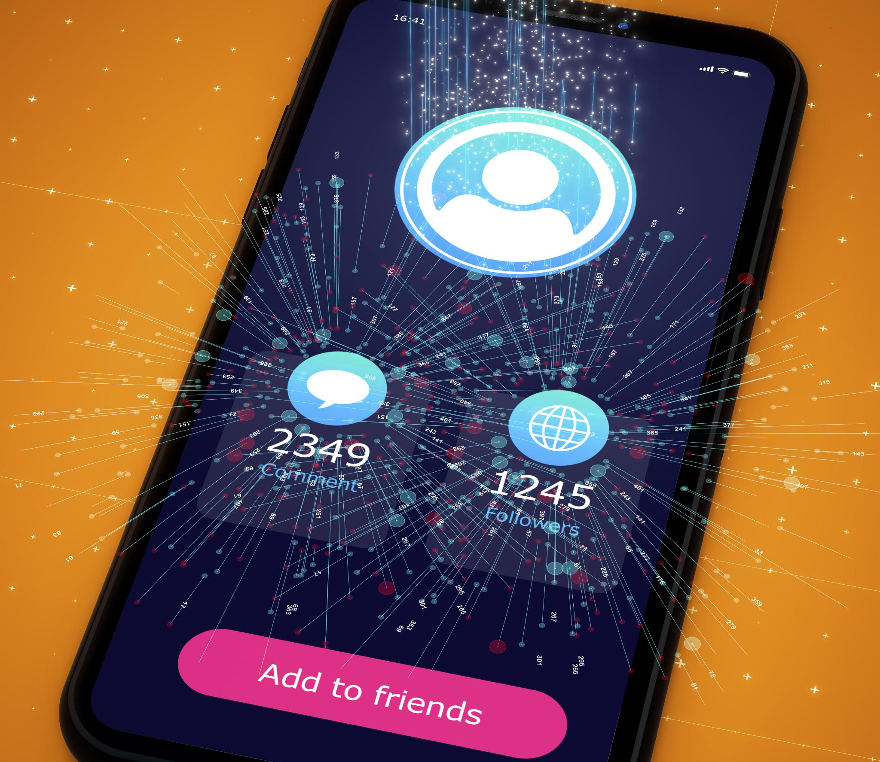
Phased Launch Strategy and Key Activities
Phase 1: Soft Launch
Target tier 2 cities with a closed beta and exclusive referral access to gather rapid user feedback.
Phase 2: Regional Launch
Expand to major metro cities with full features and marketing campaigns using influencers and incentives.
Phase 3: National Expansion
Scale aggressively across 50+ cities focusing on premium features, B2B partnerships, and preparing international plans.
Launch Timeline and Milestones
Timeline includes pre-launch testing, phased launches, user targets, transaction volumes, and funding preparation.
Notes:
--- Launch Strategy Phase 1: Soft Launch (Months 1-2) Target Cities: Pune, Jaipur (tier 2 focus for testing) User Target: 10K users per city Approach: Closed beta with 1,000 power users Referral-only access to create exclusivity Intensive user feedback collection and rapid iteration Local partnerships with 100 merchants per city Key Activities: App store optimization and initial listing Local PR and media coverage University campus partnerships Merchant onboarding drives Phase 2: Regional Launch (Months 3-6) Target Cities: Mumbai, Delhi, Bangalore, Hyderabad, Chennai User Target: 500K total users Approach: Full feature launch with marketing campaigns Influencer partnerships and social media marketing Cashback and referral incentives Strategic partnerships with local businesses Key Activities: Digital advertising campaigns (Google, Facebook, Instagram) Outdoor advertising in high-traffic areas Partnership with delivery platforms and e-commerce Customer support center establishment Phase 3: National Expansion (Months 7-18) Target Cities: Top 50 cities in India User Target: 5M total users Approach: Aggressive growth marketing and user acquisition Product differentiation and premium features B2B partnerships and enterprise solutions International expansion planning Key Activities: Television and radio advertising Cricket and entertainment sponsorships Banking partnerships and co-branded products Acquisition of smaller regional players Launch Timeline and Milestones Pre-Launch (Month 0) Final app development and testing Payment gateway integrations complete Initial merchant partnerships signed (500+ merchants) Beta user community established (1,000 users) Customer support infrastructure ready Soft Launch (Months 1-2) Launch in Pune and Jaipur Achieve 20K registered users Process $2M in transaction volume Maintain 95%+ transaction success rate Gather 500+ user feedback responses Regional Launch (Months 3-6) Launch in 5 metro cities Achieve 500K registered users Process $50M in monthly transaction volume Onboard 5K+ merchant partners Establish local customer support in each city National Expansion (Months 7-18) Launch in 50+ cities across India Achieve 5M registered users Process $500M in monthly transaction volume Become top 3 payment app in target cities Prepare for Series A funding round Image source: Microsoft 365 content library

Slide 33
Marketing and Customer Acquisition Strategies
Channel | Target CAC | Expected LTV | LTV:CAC Ratio
Organic (Referrals) | $2 | $80 | 40:1
Social Media Ads | $8 | $60 | 7.5:1
Search Ads | $12 | $70 | 5.8:1
Influencer Marketing | $6 | $50 | 8.3:1
Partnership | $4 | $65 | 16.3:1
Notes:
Marketing Strategy Digital Marketing (60% of marketing budget) Search Engine Marketing: Google Ads for high-intent keywords ("UPI app", "digital payment app") App Store Optimization (ASO) for discovery YouTube pre-roll ads targeting finance and tech content Social Media Marketing: Instagram and Facebook campaigns targeting young professionals LinkedIn campaigns for small business owners Twitter engagement during major events and festivals TikTok/Instagram Reels for viral content and app demos Content Marketing: Financial literacy blog and resources YouTube channel with payment tutorials Podcast sponsorships on finance and business topics SEO-optimized comparison content Partnership Marketing (25% of marketing budget) Strategic Partnerships: Regional banks for co-branded UPI handles E-commerce platforms for integrated payments Delivery apps for payment processing Educational institutions for campus payments Affiliate and Referral Programs: User referral rewards (₹50 for referrer, ₹25 for referee) Merchant referral programs Influencer and blogger partnerships Cashback partnerships with popular brands Traditional Marketing (15% of marketing budget) Outdoor Advertising: Metro station and bus stop ads in target cities Billboard campaigns during festival seasons Airport and railway station advertising Local newspaper and radio sponsorships Event Marketing: Fintech conference participation and sponsorships Trade show presence for B2B segments Cricket match sponsorships and activations College fest partnerships and campus events Customer Acquisition Strategy User Acquisition Channels Organic Channels (Target: 40% of users): App store optimization and organic discovery Word-of-mouth and referral programs Content marketing and SEO PR and media coverage Paid Channels (Target: 60% of users): Google and Facebook advertising Influencer partnerships and sponsored content Cashback and promotional campaigns Partnership-driven acquisitions Customer Acquisition Cost (CAC) Targets Customer Acquisition Strategy User Acquisition Channels Organic Channels (Target: 40% of users): App store optimization and organic discovery Word-of-mouth and referral programs Content marketing and SEO PR and media coverage Paid Channels (Target: 60% of users): Google and Facebook advertising Influencer partnerships and sponsored content Cashback and promotional campaigns Partnership-driven acquisitions Customer Acquisition Cost (CAC) Targets

Slide 34
Retention, Engagement, and Loyalty Programmes
Onboarding Optimization
Simplified 3-step registration with interactive tutorials ensures smooth first transactions and early success moments.
Engagement Tactics
Push notifications, spending insights, gamification, and personalised offers keep users actively engaged.
Loyalty Programs
Cashback, tier-based rewards, exclusive discounts, and special occasion rewards foster long-term loyalty.
Notes:
--- Retention and Engagement Strategy Onboarding Optimization: 3-step simplified registration process Interactive tutorial for first transaction Progressive feature introduction Early success moments (first successful payment) Engagement Tactics: Push notifications for bill due dates Spending insights and monthly reports Gamification with payment streaks and achievements Personalized offers based on transaction history Loyalty Programs: Cashback on frequent transactions Tier-based rewards (Silver, Gold, Platinum users) Exclusive merchant discounts and offers Anniversary and birthday special rewards Image source: Microsoft 365 content library

Slide 35
Product Roadmap and Risk Assessment
Notes:
Release Planning and Quarterly Roadmap, Team Structure and Development Methodology, Risk Categories and Mitigation Strategies

Slide 36
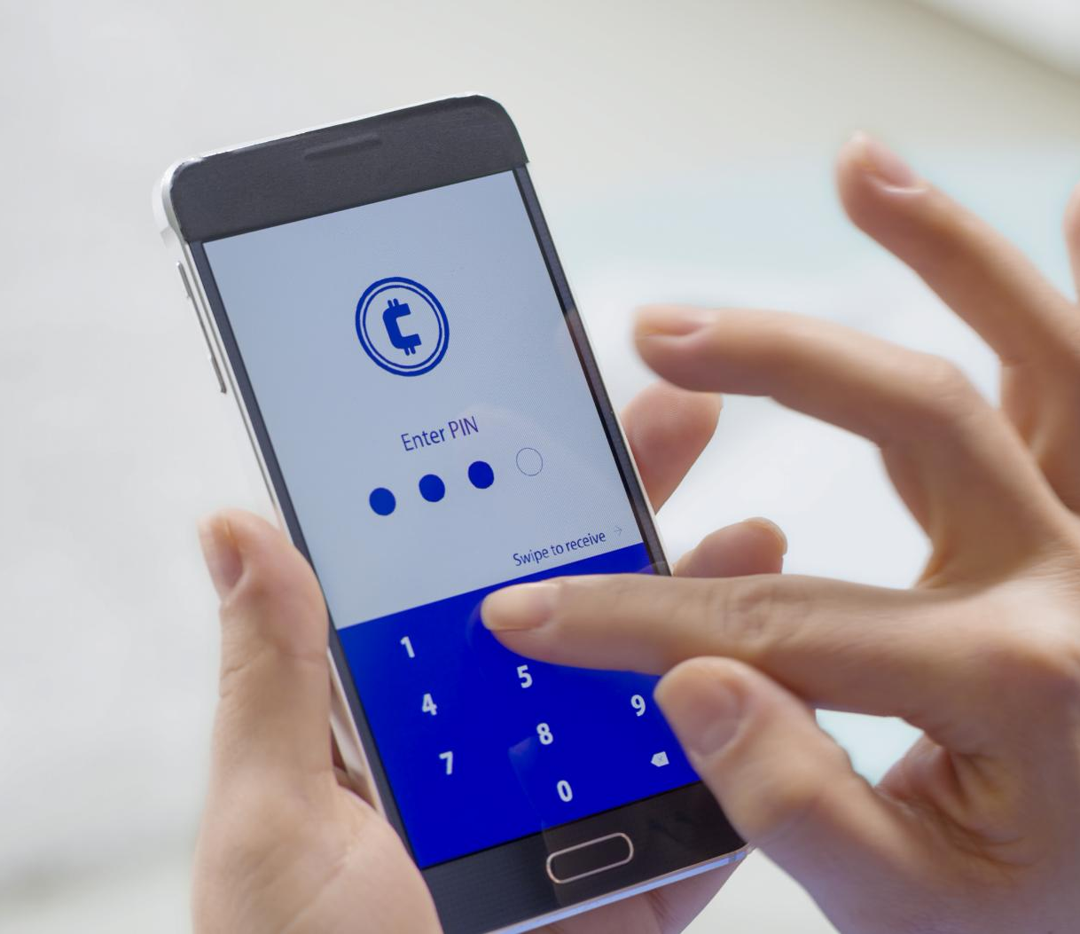
Release Planning and Quarterly Roadmap
MVP and Core Features
Initial release focuses on core payment functions like user registration, KYC, UPI linking, and basic transactions.
Enhanced User Experience
Subsequent releases add AI-driven expense analytics, budget tools, and merchant discovery for better UX.
Business Growth and Monetization
Focus on merchant onboarding, business dashboards, rewards programs, and revenue generation features.
Scale, Optimization, and Platform Expansion
Later phases include performance enhancements, premium features, financial services, and platform expansion.
Notes:
--- 9. Product Roadmap {#roadmap} Release Planning Overview The PayEase product roadmap follows an agile development approach with quarterly releases and monthly feature updates. Each release focuses on specific user segments and business objectives while maintaining a cohesive product vision. Version 1.0 - MVP (Month 1-3) Theme: Core Payment Functionality Objective: Establish basic payment infrastructure and user acquisition foundation Sprint 1-2 (Months 1-1.5): Foundation Core Features: User registration and KYC integration UPI ID creation and bank account linking Basic P2P money transfers Transaction history and receipts Security PIN and biometric authentication Technical Milestones: Backend API development (User, Payment, Transaction services) Database schema and security implementation NPCI UPI integration and testing Mobile app core functionality (iOS and Android) Basic admin dashboard for monitoring Sprint 3-4 (Months 1.5-3): Payment Expansion Core Features: QR code scanning and generation Contact-based money transfers Bill payment integration (utilities, mobile, DTH) Transaction notifications and alerts Customer support chat integration Technical Milestones: QR code generation and scanning SDK BBPS integration for bill payments Push notification system Contact list integration and synchronization Error handling and retry mechanisms Success Metrics: 50K registered users $10M monthly transaction volume 95% transaction success rate 4.0+ app store rating Version 1.1 - Enhanced Experience (Month 4-6) Theme: User Experience and Intelligence Objective: Differentiate through superior UX and intelligent features Sprint 5-6 (Months 4-4.5): Smart Features Enhanced Features: AI-powered expense categorization Spending analytics and insights Budget setting and alerts Transaction search and filtering Split bill functionality Technical Milestones: Machine learning model for transaction categorization Analytics engine and data visualization Budget management system Advanced search and filtering backend Group payment and splitting logic Sprint 7-8 (Months 4.5-6): Merchant Focus Enhanced Features: Merchant discovery and search Store ratings and reviews Location-based merchant recommendations Favorite merchants and quick pay Multi-language support (Hindi + 2 regional languages) Technical Milestones: Geolocation and mapping integration Merchant onboarding portal Review and rating system backend Localization framework implementation Quick pay and favorites functionality Success Metrics: 500K registered users $50M monthly transaction volume 1K+ merchant partners 35% user retention (Day 30) Version 1.2 - Business Growth (Month 7-9) Theme: Business Features and Monetization Objective: Enable merchant ecosystem and revenue generation Sprint 9-10 (Months 7-7.5): Business Dashboard Business Features: Merchant registration and onboarding Business analytics dashboard Transaction reporting and reconciliation Bulk payment processing Invoice generation and management Technical Milestones: Merchant portal development Business analytics and reporting engine Bulk payment processing system Invoice management system Merchant API for integration Sprint 11-12 (Months 7.5-9): Rewards and Loyalty Enhanced Features: Cashback and rewards program Loyalty points system Referral program implementation Merchant-specific offers Seasonal promotions and campaigns Technical Milestones: Rewards calculation engine Loyalty points management system Referral tracking and reward distribution Offer management platform Campaign management tools Success Metrics: 1M registered users $100M monthly transaction volume 5K+ merchant partners Break-even on unit economics Version 1.3 - Scale and Optimization (Month 10-12) Theme: Performance and Advanced Features Objective: Scale infrastructure and introduce premium features Sprint 13-14 (Months 10-10.5): Performance Optimization Technical Enhancements: Database optimization and sharding API performance improvements Advanced caching strategies Load balancing and auto-scaling Enhanced monitoring and alerting Advanced Features: Advanced expense analytics (categorization, trends, predictions) Financial health score and recommendations Recurring payment automation Advanced security features (fraud detection, behavioral analysis) Sprint 15-16 (Months 10.5-12): Premium Features Premium Features: Credit score checking integration Investment tracking and insights Tax calculation and reporting Advanced business analytics for merchants API access for third-party integrations Technical Milestones: Credit bureau integration (CIBIL) Investment data aggregation Tax calculation engine Advanced analytics platform Developer API and documentation Success Metrics: 2M registered users $200M monthly transaction volume 10K+ merchant partners 45% user retention (Day 30) Version 2.0 - Platform Expansion (Month 13-18) Theme: Financial Services Platform Objective: Transform into comprehensive fintech platform Sprint 17-20 (Months 13-15): Financial Services New Services: Personal loans and credit products Insurance marketplace integration Investment products (mutual funds, stocks) Gold purchase and storage International remittance Technical Milestones: Lending platform development Insurance aggregation APIs Investment platform integration Gold trading and storage system FEMA compliance for international transfers Sprint 21-24 (Months 15-18): Advanced Platform Platform Features: Open banking integration Cryptocurrency support IoT payment integration Voice-activated payments AR/VR payment experiences Technical Milestones: Open banking API compliance Blockchain and crypto integration IoT device connectivity Voice recognition and processing AR/VR development frameworks Success Metrics: 5M registered users $500M monthly transaction volume Top 3 fintech app in India Profitable operations Feature Prioritization Framework RICE Scoring for Future Features Image source: Microsoft 365 content library

Slide 37
Team Structure and Development Methodology
Engineering Team Composition
The engineering team consists of 12 members covering backend, frontend, DevOps, QA, and security roles for robust development.
Product and Business Teams
Product and business teams focus on strategy, design, analysis, marketing, compliance, and customer support to drive project success.
Agile Development Methodology
Agile/Scrum framework with 2-week sprints ensures rapid delivery, continuous integration, and blue-green deployment for quality releases.
Notes:
--- Development Resources and Timeline Team Structure Engineering Team (12 members): 1 Engineering Manager 3 Backend Engineers (Node.js, APIs, Database) 3 Frontend Engineers (React Native, Mobile) 2 DevOps Engineers (AWS, Infrastructure) 2 QA Engineers (Testing, Automation) 1 Security Engineer (Compliance, Security) Product Team (4 members): 1 Product Manager (Strategy, Roadmap) 1 Product Designer (UX/UI Design) 1 Product Analyst (Data, Metrics) 1 Technical Writer (Documentation) Business Team (6 members): 1 Business Development Manager 2 Marketing Specialists 1 Compliance Officer 2 Customer Support Representatives Development Methodology Framework: Agile/Scrum with 2-week sprints Planning: Quarterly OKRs with monthly feature releases Testing: Continuous integration with automated testing Deployment: Blue-green deployment with feature flags Image source: Microsoft 365 content library

Slide 38

Risk Categories and Mitigation Strategies
Technical Risk Management
Mitigate system downtime and integration failures with redundant systems, real-time monitoring, and multiple payment gateways.
Security and Compliance Risks
Address data breaches and regulatory changes via encryption, audits, compliance teams, and proactive legal engagement.
Market and Business Challenges
Combat competition and acquisition costs through strong branding, diversified marketing, and strategic partnerships.
Financial and Operational Risks
Manage funding and personnel risks with cash monitoring, investor relations, and employee engagement programs.
Notes:
--- 10. Risk Assessment {#risk-assessment} Risk Categories and Mitigation Strategies Technical Risks Risk 1: System Downtime and Performance Issues Probability: Medium (30%) Impact: High Description: Server crashes, database failures, or API downtimes affecting transaction processing Mitigation Strategies: Implement redundant systems and load balancers 99.9% uptime SLA with cloud providers (AWS) Real-time monitoring and automated failover systems Regular disaster recovery testing Circuit breaker patterns for external API dependencies Risk 2: Security Breaches and Data Theft Probability: Low (15%) Impact: Critical Description: Unauthorized access to user data or financial information Mitigation Strategies: End-to-end encryption for all sensitive data Regular security audits and penetration testing Multi-factor authentication and biometric verification PCI DSS and ISO 27001 compliance Bug bounty program for vulnerability discovery Risk 3: Integration Failures with Banking Systems Probability: Medium (25%) Impact: High Description: UPI gateway failures or bank API connectivity issues Mitigation Strategies: Multiple payment gateway partnerships Real-time health monitoring of external APIs Graceful error handling and user communication Fallback payment methods implementation Regular testing with banking partners Regulatory and Compliance Risks Risk 4: Regulatory Changes and Non-Compliance Probability: High (60%) Impact: High Description: New RBI/SEBI regulations affecting payment operations Mitigation Strategies: Dedicated compliance team and legal counsel Regular regulatory training for all team members Proactive engagement with regulatory bodies Flexible system architecture for quick compliance updates Industry association membership for early regulation insights Risk 5: KYC and AML Compliance Issues Probability: Medium (35%) Impact: High Description: Inadequate customer verification leading to regulatory penalties Mitigation Strategies: Automated KYC verification with multiple providers Real-time transaction monitoring for suspicious activities Regular compliance audits and staff training Clear escalation procedures for compliance issues Partnership with specialized compliance service providers Market and Business Risks Risk 6: Intense Competition from Established Players Probability: High (80%) Impact: High Description: PhonePe, GPay, and Paytm launching competitive features or aggressive pricing Mitigation Strategies: Focus on differentiated value propositions (AI insights, merchant services) Build strong brand loyalty through superior user experience Strategic partnerships for competitive moats Rapid innovation and feature development cycles Niche market focus before mass market expansion Risk 7: User Acquisition Cost Escalation Probability: High (70%) Impact: Medium Description: Increasing competition driving up digital marketing costs Mitigation Strategies: Diversified acquisition channels (organic, referral, partnership) Focus on high-LTV user segments Strong referral and word-of-mouth programs Content marketing and SEO for organic growth Strategic partnerships for cost-effective user acquisition Risk 8: Merchant Adoption Challenges Probability: Medium (40%) Impact: Medium Description: Difficulty in onboarding and retaining merchant partners Mitigation Strategies: Simplified merchant onboarding process (5-minute setup) Competitive transaction fees and settlement terms Value-added services (analytics, inventory management) Dedicated merchant support and training programs Local partnership strategies for market penetration Financial and Operational Risks Risk 9: Funding and Cash Flow Issues Probability: Medium (30%) Impact: High Description: Inability to raise sufficient funding for growth and operations Mitigation Strategies: Conservative cash management and burn rate monitoring Multiple funding sources and investor relationships Revenue diversification through multiple monetization streams Flexible business model adaptation based on market conditions Clear path to profitability within 18 months Risk 10: Key Personnel Loss Probability: Medium (35%) Impact: Medium Description: Loss of critical team members affecting product development and operations Mitigation Strategies: Competitive compensation and equity packages Strong company culture and employee engagement programs Cross-training and knowledge documentation Succession planning for key roles Remote work flexibility and work-life balance Risk Monitoring and Response Framework Monthly Risk Assessment: Risk probability and impact reassessment Mitigation strategy effectiveness review New risk identification and analysis Stakeholder communication and updates Quarterly Risk Review: Comprehensive risk register update Business continuity plan testing Insurance coverage adequacy review Crisis response procedure validation Risk Escalation Matrix: Low Risk: Team lead management Medium Risk: Department head involvement High Risk: Executive team notification Critical Risk: Board and investor communication Image source: Microsoft 365 content library

Slide 39
Conclusion: Strategic Path Forward for PayEase
Comprehensive Strategy
PayEase’s strategy fully addresses market opportunities and evolving user needs for digital payments.
Robust Technology
The platform integrates advanced technology ensuring secure and seamless payment processing.
Competitive Positioning
PayEase is positioned strongly against competitors through innovation and customer focus.
Growth and Risk Management
Clear success metrics and risk management plans support sustainable and impactful growth.
Notes:
To conclude, PayEase’s comprehensive strategy addresses market opportunities, user needs, robust technology, competitive positioning, and clear success metrics. With a detailed roadmap and risk management, PayEase is poised for impactful growth in the digital payments industry.

